Slide 1
ONLINE CLASS
GRAPH THEORY
BICTE $6^{TH}$ SEMESTER
2078/03/22
PRESENTED BY KALYAN DAHAL

Slide 2
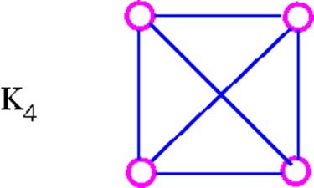
Graph Planarity
A graph G is planar if it can be drawn in the plane in such a way that no two edges meet each other except at a vertex to which they are incident. Any such drawing is called a plane drawing of G.
For example, the graph K₄ is planar, since it can be drawn in the plane without edges crossing.

Slide 3
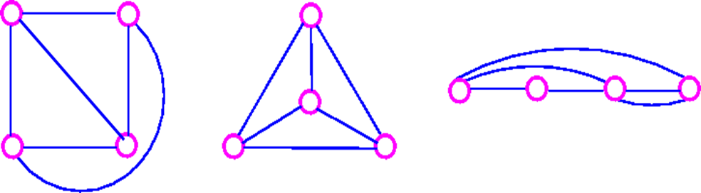
Continued….
The three plane drawings of K₄ are:

Slide 4
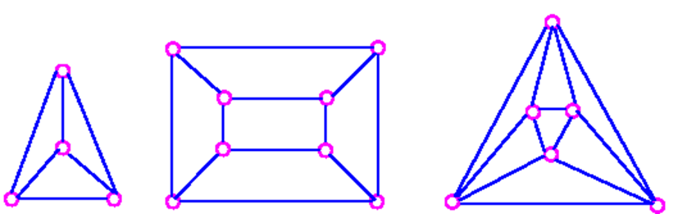
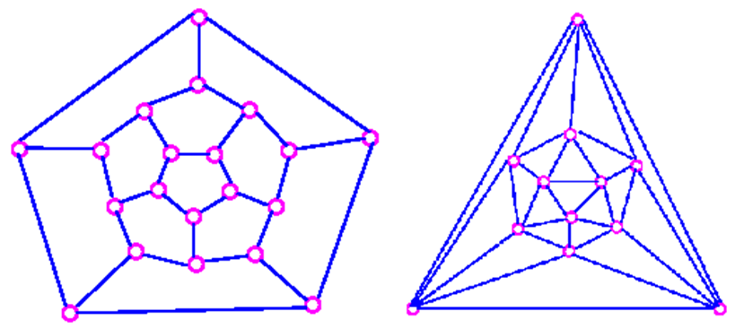
Continued….
The five Platonic graphs are all planar.

Slide 5
Continued….
On the other hand, the complete bipartite graph K_{3,3} is not planar, since every drawing of K_{3,3} contains at least one crossing. why? because K_{3,3} has a cycle which must appear in any plane drawing.
To study planar graphs, we restrict ourselves to simple graphs.
If a planar graph has multiple edges or loops.
Collapse the multiple edges to a single edge.
Remove the loops.
Draw the resulting simple graph without crossing.
Insert the loops and multiple edges.

Slide 6
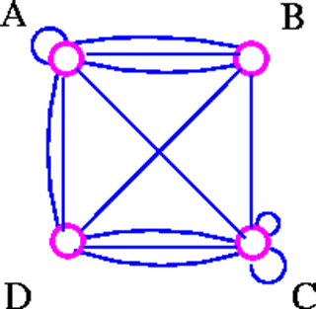
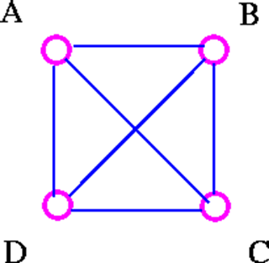
Continued….
Remove loops and multiple edge.

Slide 7
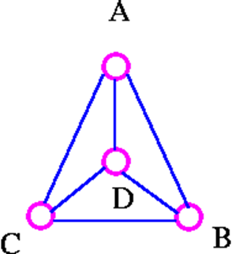
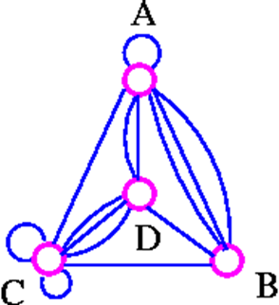
Continued….
Draw without multiple edge.
Insert loops and multiple edges

Slide 8
Euler's Formula
If G is a planar graph, then any plane drawing of G divides the plane into regions, called faces. One of these faces is unbounded, and is called the infinite face. If f is any face, then the degree of f (denoted by deg f) is the number of edges encountered in a walk around the boundary of the face f. If all faces have the same degree (g, say), the G is face-regular of degree g.
For example, the following graph G has four faces, f₄ being the infinite face.

Slide 9
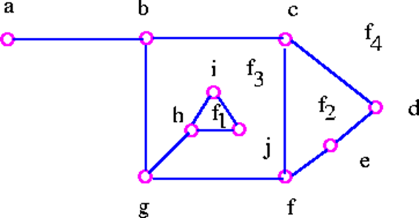
Continued….
It is easy to see from above graph that deg f₁=3, deg f₂=4, deg f₃=9, deg f₄=8.

Slide 10
Continued….
Note that the sum of all the degrees of the faces is equal to twice the number of edges in the the graph , since each edge either borders two different faces (such as bg, cd, and cf) or occurs twice when walk around a single face (such as ab and gh). The Euler's formula relates the number of vertices, edges and faces of a planar graph. If v, e, and r denote the number of vertices, edges, and faces respectively of a connected planar graph, then we get v – e + r = 2.
The Euler formula tells us that all plane drawings of a connected planar graph have the same number of faces namely, 2 + e - v.

Slide 11
Theorem 1 (Euler's Formula) Let G be a connected planar graph, and let v, e and r denote, respectively, the numbers of vertices, edges, and faces in a plane drawing of G. Then v - e + r = 2.
Proof : We imply mathematical induction on edges, e. The induction is obvious for e=0 since in this case v=1 and r=1. Assume that the result is true for all connected plane graphs with fewer than e edges, where e is greater than or equal to 1, and suppose that G has e edges. If G is a tree, then v=e+1 and r=1 so the desired formula follows. On the other hand, if G is not a tree, let C be a cycle edge of G and consider G-C. The connected plane graph G-C has n vertices, e-1 edges, and r-1 faces so that by the inductive hypothesis,
v - (e - 1) + (r - 1) = 2
which implies that v - e + r = 2. proved

Slide 12
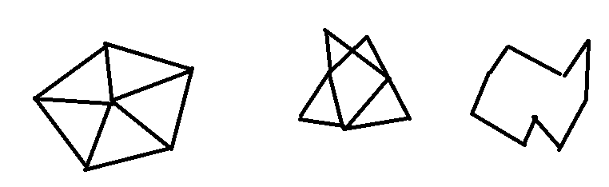
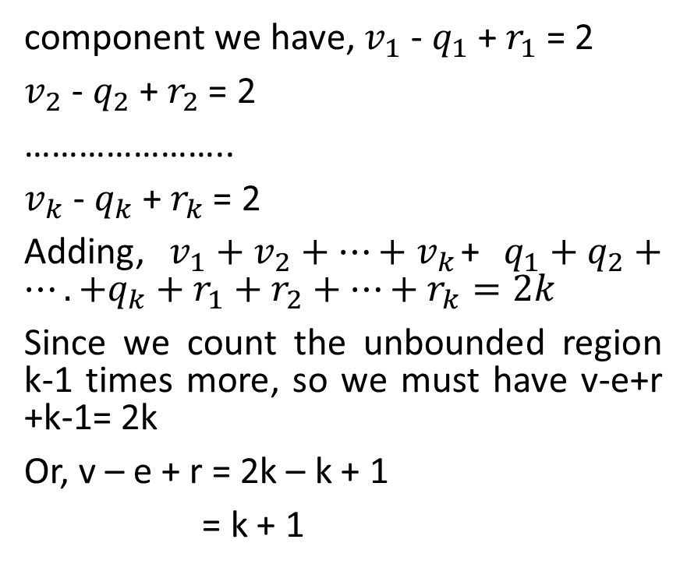

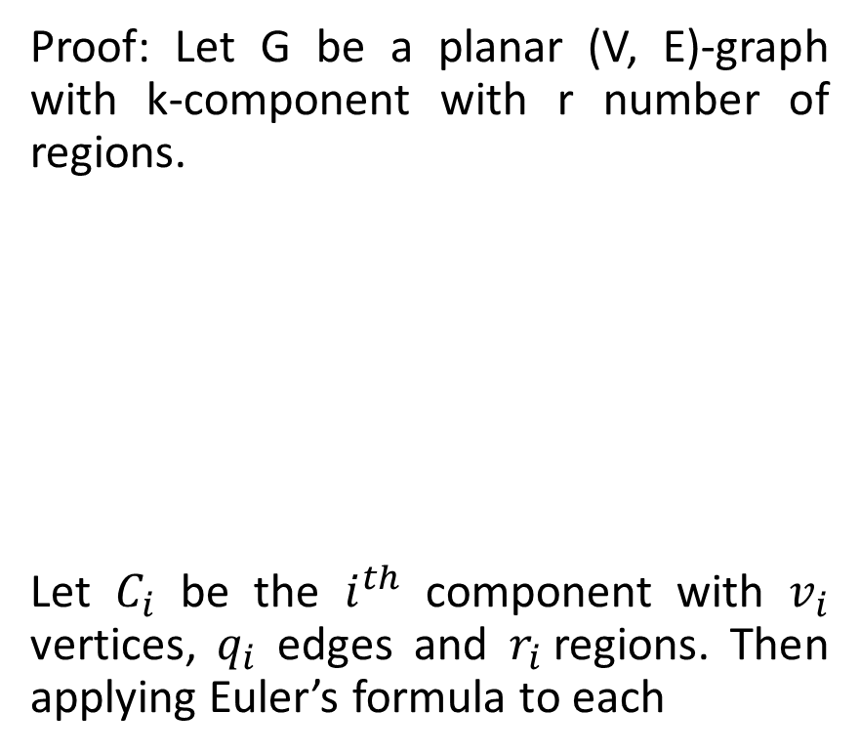


Let G be a planar (V, E)-graph with k-component with r regions, then v – e + r = k + 1
Proof: Let G be a planar (V, E)-graph with k-component with r number of regions.
Let $C_{i}$ be the $i^{th}$ component with $v_{i}$ vertices, $q_{i}$ edges and $r_{i}$regions. Then applying Euler’s formula to each
component we have, $v_{1}$ - $q_{1}$ + $r_{1}$ = 2
$v_{2}$ - $q_{2}$ + $r_{2}$ = 2
…………………..
$v_{k}$ - $q_{k}$ + $r_{k}$ = 2
Adding, $v_{1}+v_{2}+…+v_{k}$+ $q_{1}+q_{2}+….+q_{k}+r_{1}+r_{2}+…+r_{k}=2k$
Since we count the unbounded region k-1 times more, so we must have v-e+r +k-1= 2k
Or, v – e + r = 2k – k + 1
= k + 1
$$C_{1}$$
$$C_{2}$$
$$C_{3}$$

Slide 13
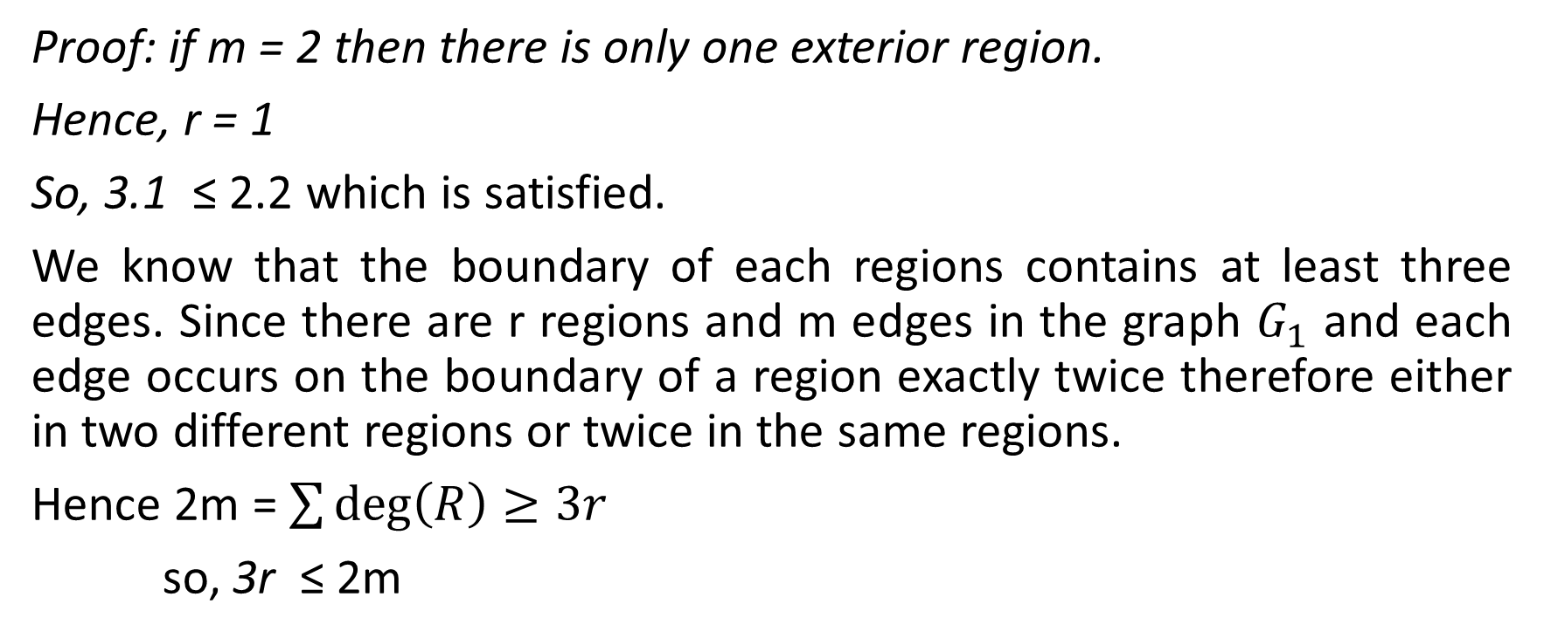
Corollary 1 Let G be a connected planar simple graph with m ≥ 2 m edges and r regions. Then 3r ≤ 2m.
Proof: if m = 2 then there is only one exterior region.
Hence, r = 1
So, 3.1 ≤ 2.2 which is satisfied.
We know that the boundary of each regions contains at least three edges. Since there are r regions and m edges in the graph $G_{1}$ and each edge occurs on the boundary of a region exactly twice therefore either in two different regions or twice in the same regions.
Hence 2m = $\sum{\deg\left(R\right)≥3r}$
so, 3r ≤ 2m

Slide 14
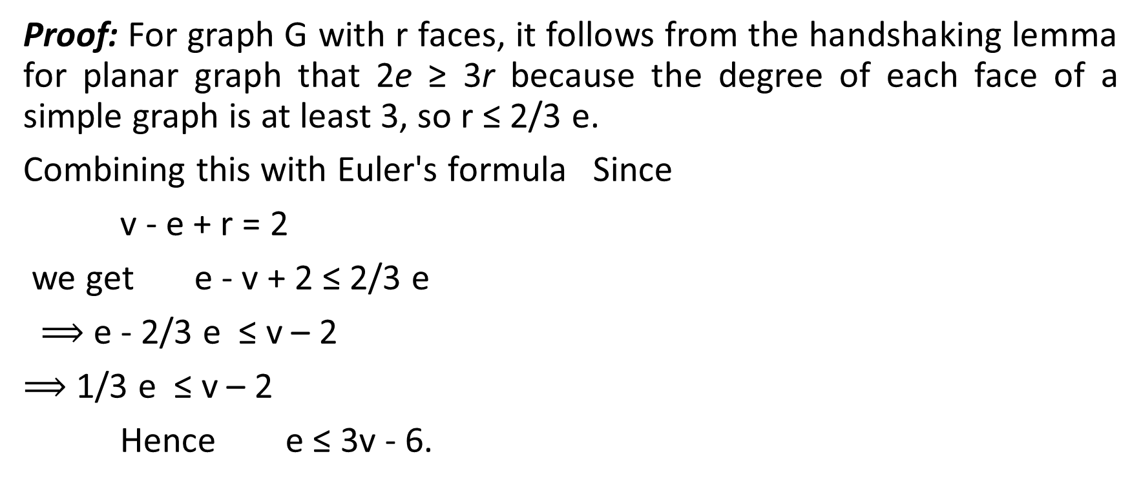
Corollary 1 Let G be a connected planar simple graph with n vertices, where n ≥ 3 and m edges. Then m ≤ 3n - 6.
Proof: For graph G with r faces, it follows from the handshaking lemma for planar graph that 2e ≥ 3r because the degree of each face of a simple graph is at least 3, so r ≤ 2/3 e.
Combining this with Euler's formula Since
v - e + r = 2
we get e - v + 2 ≤ 2/3 e
$⟹$ e - 2/3 e ≤ v – 2
$⟹$ 1/3 e ≤ v – 2
Hence e ≤ 3v - 6.

Slide 15
show that K₅ is non-planar.
Proof:
Suppose that K₅ is a planar graph. Since K₅ has 5 vertices and 10 edges it follows from e ≤ 3v - 6 that
e ≤ 3v – 6
10 ≤ (3 × 5) - 6
10 ≤ 9. This contradiction shows that K₅ is non planar.
It is important to note that K_{3,3} has 6 vertices and 9 edges, and it is true that 9 ≤ (3 × 6) - 6 = 12. This fact simply shows that we cannot use Corollary 1 to prove that K_{3,3} is non-planar. This leads us to following corollary.

Slide 16
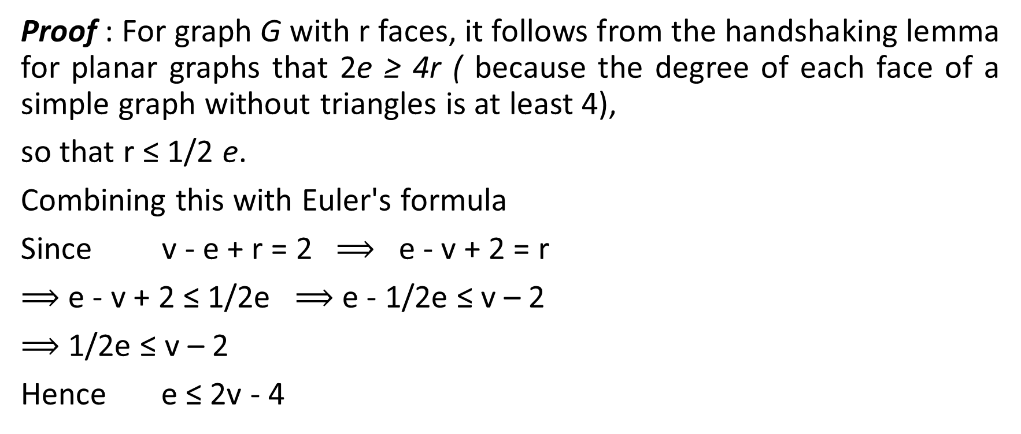
Corollary 2 Let G be a connected planar simple graph with v vertices and e edges, and no triangles. Then e ≤ 2v - 4.
Proof : For graph G with r faces, it follows from the handshaking lemma for planar graphs that 2e ≥ 4r ( because the degree of each face of a simple graph without triangles is at least 4),
so that r ≤ 1/2 e.
Combining this with Euler's formula
Since v - e + r = 2 $⟹$ e - v + 2 = r
$⟹$ e - v + 2 ≤ 1/2e $⟹$ e - 1/2e ≤ v – 2
$⟹$ 1/2e ≤ v – 2
Hence e ≤ 2v - 4

Slide 17
show that K_{3,3} is non-planar.
Proof:
Suppose that K_{3,3} is a planar graph. Since K_{3,3} has 6 vertices and 9 edges and no triangles.
It follows from e ≤ 2v - 4 that
e ≤ 2v – 4
9 ≤ (2×6) - 4 = 8. This contradiction shows that K_{3,3} is non-planar.

Slide 18
Corollary 3 Let G be a connected planar simple graph. Then G contains at least one vertex of degree 5 or less.
Proof: We have e ≤ 3v-6. Suppose that every vertex in G has degree 6 or more. Then we have 2e ≥ 6v (because 2e is the sum of the vertex-degree), and therefore e ≥ 3v . This contradiction shows that at least one vertex has degree 5 or less. proved
Now we will show by using Euler's formula that there are only five regular convex polyhedra - namely, the tetrahedron, cube, octahedron, dodecahedron, and icosahedron.

Slide 19


